Slide 1
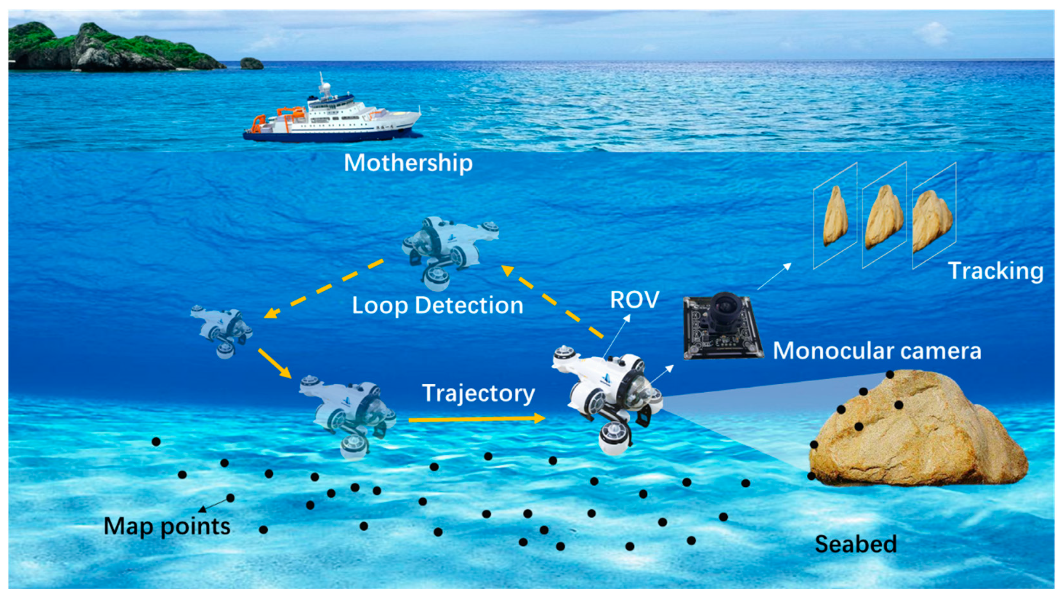
Research Study
By Wilfred Auxilian George

Slide 2
Paper 1: MAM3SLAM: Towards underwater-robust multi-agent visual SLAM Author → Juliette, Claire, Vincent Year → 2024
Includes multi-agent tracking, local mapping, loop closure, and map merging.
Remotely Operated Vehicles (ROVs) equipped with monocular RGB cameras (BLUEROV2).
Tested in real underwater conditions (pool + open sea) and Datasets collected using BlueROV2 and GoPro for sea trials.
MAM3SLAM is more accurate and robust ,than ORB-SLAMM and CCM-SLAM and it outperforms all SLAM algorithms.
Built on ORB-SLAM Atlas using ORB-SLAM3 codebase and it is a Fully centralized system with all computation done on a server.
Server performs map merging and global optimization.
Allows collaborative mapping & relative localization.
Handles underwater visual challenges (dropouts, blur, poor textures) effectively.
MAM3SLAM successfully estimates the individual and relative localization of the agents(ROV) with an error lower than 5 cm on three out of the four test sequences, and is twice as accurate as competing multi-agent works in challenging visual conditions with frequent visual dropouts, poor textures, low framerate and fast motion.

Slide 3
Paper 2: UVS: underwater visual SLAM—a robust monocular visual SLAM system for lifelong underwater operations Author → Marco, Annette, Edmund, Martin Year →2023
UVS has Three-view initialization(Three Images) for better pose accuracy, Brute-force descriptor matching for denser maps(compares every possible pair of features), Motion model to handle tracking loss(When the camera loses sight e.g., due to blur, occlusion, or darkness), UVS uses a mathematical model of motion (constant velocity) to predict where the camera is moving — even without visual input.
Tested using monocular cameras on ROVs and AUVs.
includes custom underwater datasets and no need for depth sensors or external localization—camera-only navigation(builds a map just using camera , no sonar or GPY or IMU).
Images processed via FIFO queue and Pruning strategy manages memory for long-term missions( In Slam, the map gets bigger overtime so by pruning it removes old or lesser data)
UVS outperforms ORB-SLAM and LDSO in underwater environments
Operates in sequences where ORB-SLAM fails
Robust to visual loss, low lighting, and low scene overlap.
Achieves up to 34.6% lower RMSE(Root mean square error→how close is the robot estimated path to the real path, Low RMSE=Better accuracy) and 33.3% more loop closures(When the robot returns to a previously visited place, loop closure recognizes it and corrects drift in the map and path).
UVS showed up to 34.6% lower RMSE than ORB-SLAM — that means it's more accurate.

Slide 4
Paper 3: Real-time Monocular Visual Odometry for Turbid and Dynamic Underwater Environments Author → Maxime, Julien0, Pauline, Vincent Year → 2020
UW-VO System is used.
No IMU, SONAR or DVL is used.
It was tested at 500m depth in Mediterranean Sea.
Implemented in C++ with ROS, uses KLT Optical Flow Tracker(OpenCV, Tracks feature points across video frames), pose estimation via P3P + RANSAC (OpenGV, Estimates the camera’s position and orientation using 3 known 3D-2D point correspondences (P3P), and filters out bad matches using RANSAC), Windowed local Bundle adjustment(g2o, Optimizes camera poses and 3D map points over a sliding window of recent keyframes and reduces drift) and retracking for feature robustness(Recovers temporarily lost features).
The frame per second was 25-35 ms.
Outperforms ORB-SLAM2, LSD-SLAM, and SVO in turbid/dynamic underwater scenes.
Robust to turbidity, occlusion, and fish motion.
Runs in real-time on low-power CPU.
Accuracy and performance is higher compared to other SLAM systems .

Slide 5
Paper 4: Investigation of the challenges of Underwater Visual Monocular SLAM Author → Michele, David, Mengkun, Kevin Year → 2023
It uses Girona 500 AUV for real-sea data.
It explicitly excludes sensor fusion approaches and focuses on camera-based approach.
Evaluated SLAM systems: ORB-SLAM2, ORB-SLAM3, LSD-SLAM, BADSLAM, GRADSLAM performance in-air vs underwater under various lighting and turbidity levels.
Depth estimated using different methods: Monodepth2, UW-Net, UDepth, Colmap.
Monodepth2→ Predicts depth from a single image using neural networks, requires training, fails underwater.
UW-Net→learns depth from unlabelled data, requires training, failed in underwater.
UDepth→fast, loses accuracy in murky water environment, failed in underwater.
Colmap→Requires many images from different angles, Builds a sparse 3D point cloud via feature matching.
Applied 6 image enhancement techniques (CLAHE, UDCP, UW-GAN, Median, etc.), CLAHE was best overall, UW-GAN showed good results, UDCP and Median was okay but no method could work properly in real AUV missions.
SLAM works well in air, but fails in real underwater scenarios, especially under poor light & high scattering.
Image enhancement (especially CLAHE) improves SLAM performance slightly in tanks.
Even the best methods fail in AUV datasets — due to low texture, turbidity, and radiometric distortion.
ORBSLAM3 AND ORBSLAM2 worked very well and ORBSLAM3 was the best but even ORBSLAM3 struggled with noise distortion , low texture, light scattering etc. and failed in open water.
LSD-SLAM , BADSLAM and GRADSLAM completely failed as it failed in most of the cases.

Slide 6
Paper 5: Monocular Visual SLAM for Underwater Navigation in Turbid and Dynamic Environments Author → Chinthaka, Asanga, Sanjeeva Year → 2020
It uses keyframe based monocular SLAM and written in C++ with ROS integration.
Its features are KLT+Harris Corner tracking, P3P+RANSAC, Windowed Local bundle adjustment, Retracking, Loop Closure, Pose graph optimization.
Slam libraries include OpenCV(feature tracking, image processing), g2o(pose graph optimization), DBoW2(loop closure detection).
Real time capable in moderate CPU systems.
No additional sensors, camera only system is present.
Tested on underwater and real-world datasets.
Performs well in simulated and controlled underwater scenes, but still struggles in extremely poor visibility.
Successfully runs in turbid water with poor visibility, moving particles or short obstacles like fish etc.
Fails when visibility drops very low, loop closures are missed causing drift, highly dynamic scenes and sensitive to lightning shifts.

Slide 7
Paper 6: ULL-SLAM: underwater low-light enhancement for the front-end of visual SLAM Author → Zhichao, Zhe, Zhibin, Bing Year → 2023
ULL-SLAM →It is a deep learning-enhanced SLAM system specifically designed to work in very dark underwater environments.
Shared Backbone CNN (low light enhancer and feature point enhancer and matcher) is the custom neural architecture used here.
Uses a Siamese network(type of neural network that takes in two (or more) inputs, passes them through identical subnetworks (with shared weights), and compares their outputs to determine how similar they are) to match feature points across frames.
Implemented in Python + PyTorch for training, and C++/ROS-compatible for deployment.
Real-time capable (40.6 FPS) on Jetson AGX Xavier.
No additional sensors (e.g., no sonar, DVL, or IMU); works on camera-only systems.
Outperformed ORB-SLAM2, ORB-SLAM3, and Dual-SLAM in all key metrics.
Performance drops in extremely turbid scenes.
Needs High GPU for real-time inference (Jetson or equivalent).
By jointly learning image enhancement and feature extraction, it dramatically improves underwater SLAM performance.
At the same time, the proposed network can be flexibly transplanted or added to the backbone of the popular SLAM system based on feature point extraction to improve the system’s performance.

Slide 8
Paper 7: Autonomous Underwater Vehicles in Monitoring Scenario Author → Ruscio, Tani, Bresciani, Caiti Year → 2020
A monocular visual odometry (VO) approach is proposed using a bottom-looking camera in Zeno AUV.
Uses SURF features + Lowe’s ratio test + RANSAC for feature matching and motion estimation.
Resolves scale ambiguity using altitude sensor data (e.g., DVL altitude → Nortek DVL is used) and triangulated feature points.
Fuses VO velocity with attitude and depth from AHRS and pressure sensor using an Extended Kalman Filter (EKF) for full trajectory estimation.
Implemented using C++ and OpenCV.
CLAHE used for image enhancement to improve underwater contrast.
Provides accurate velocity and trajectory estimates under good visual conditions.
Uses existing onboard sensors to reduce complexity and cost.
Handles complex seabed textures (rocks, seagrass, sand) with moderate reliability.
Requires good visibility and a consistent altitude for reliable scale estimation.

Slide 9
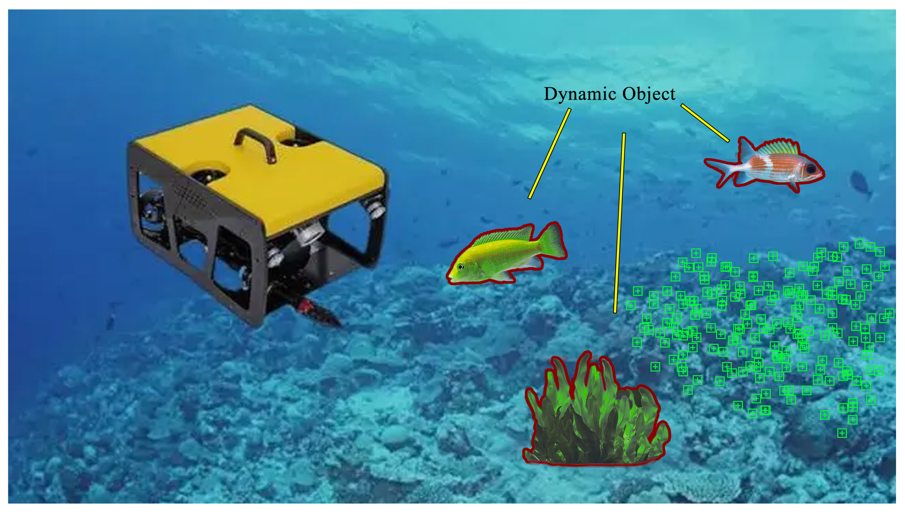
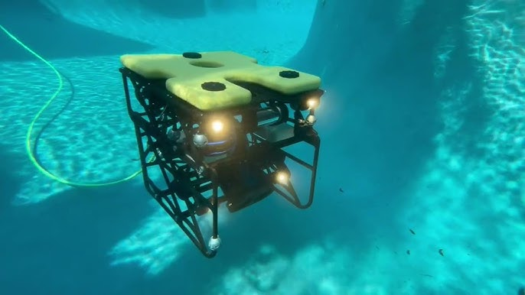
Comparative study on MMA3SLAM, UVS, UW-VO, MV-SLAM, ULL-SLAM AND MVO
For Certain Applications , it differs based on the use:-
Real-time navigation in harsh underwater conditions, short-to-medium term localization, not full map building, low power robots → Go with UW-VO
Full SLAM system, long duration missions, lifelong mapping, station-keeping detection → Use UVS
Collaborative SLAM with multiple ROVs, high system complexity, central server→ Go with MAM3SLAM
Simple AUV with depth + attitude data → MV-SLAM
Deep-sea or low-light image conditions → ULL - SLAM
Simple visual odometry with geometry → MVO
Overall → UVS >UW-VO >ULL-SLAM>MV-SLAM>MVO

Slide 10
Feature / Criteria | MAM3SLAM | UVS | UW-VO | MV-SLAM | ULL-SLAM | MVO
Architecture | Centralized multi-agent SLAM | Single-agent full SLAM | Monocular Visual Odometry | Monocular VO + EKF Fusion | Deep-learning feature-based SLAM | Multi-view Geometry (VO)
Sensor Input | Monocular camera | Monocular camera | Monocular camera | Camera + AHRS + Depth sensor | Monocular camera | Monocular camera
Loop Closure | ✅ Yes (multi-agent shared) | ✅ Yes | ❌ No | ❌ No | ✅ Yes (through SLAM backend) | ❌ No
Tracking Recovery | ✅ Inter-agent relocalization | ✅ Motion model & multi-view init | ✅ Retracking + KLT | ⚠️ Partial (dependent on EKF) | ✅ Feature re-detection supported | ⚠️ Limited
Image Enhancement | ❌ No | ❌ No | ❌ No | ✅ CLAHE | ✅ Joint enhancement + extraction | ❌ No
Best Condition | Multi-ROV with server connection | Long-term single AUV missions | Harsh turbidity + occlusion | Bottom-looking AUV with stable light | Low-light deep-sea footage | Short-range, well-lit tracking
Worst Condition | No comms, no overlap between ROVs | Severe turbidity / occlusion | Low-texture + no motion | Dynamic vegetation + non-planar | Heavy scattering & turbidity | High noise / dynamic scenes
Depth Estimation | ❌ Not needed | ❌ Not needed | ❌ No | ✅ Altitude fusion | ❌ No | ❌ No
SLAM Type | Full SLAM (multi-agent) | Full SLAM | Visual Odometry only | Visual Odometry + Filtered Pose | Full SLAM frontend (pluggable) | Visual Odometry
Hardware Requirements | Multiple ROVs + server | Monocular camera only | Monocular camera only | Camera + AHRS + Depth | Jetson Xavier GPU (for inference) | Monocular camera
Real-Time Capable | ⚠️ With server | ✅ Yes | ✅ Yes | ✅ Yes | ✅ Yes (~40 FPS) | ✅ Yes
Accuracy (RMSE / % error) | ~cm level in multi-agent tests | RMSE reduced by ~34.6% vs others | RMSE ~1–1.8% | ~1.3% trajectory error | RMSE ~1.3; ATE ~1.29 | Not reported
Loop-Aware Map Optimization | ✅ Yes | ✅ Yes | ❌ No | ❌ No | ✅ If back-end supports | ❌ No

